Slide 1
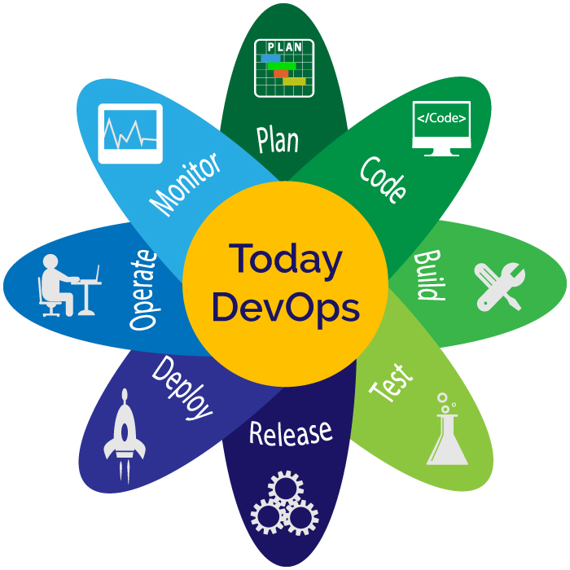
DevOps Training (Week 3)
-Presented by
Neha Agarwal

Slide 2
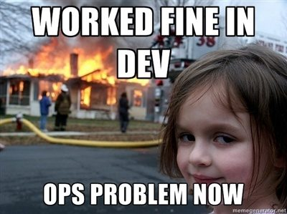
We all have been here (or will be):

Slide 3
Contents:
Builds
CI
CD
Jenkins
Ruby
Ruby Gems

Slide 4
What are Builds?
Stand alone version of a Program
Developed after compilation
Executable code
Managed by a Build Tool

Slide 5
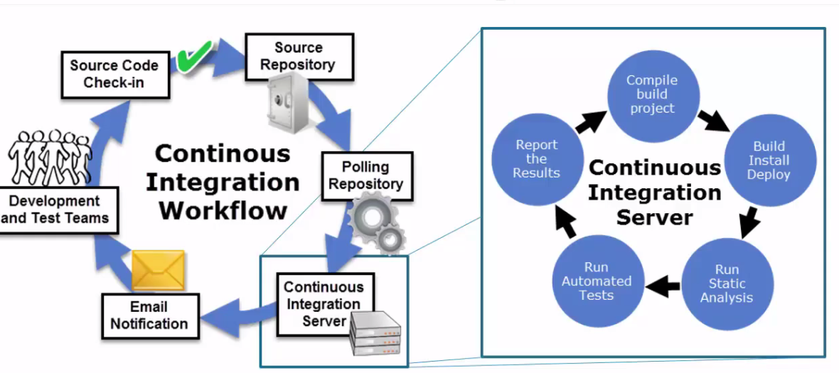
What is CI?
Automates the merging and testing of code
Catches bugs early in the development cycle
Errors are less expensive to fix
Artifacts are produced from CI systems and fed to release pipelines to drive frequent deployments.

Slide 6
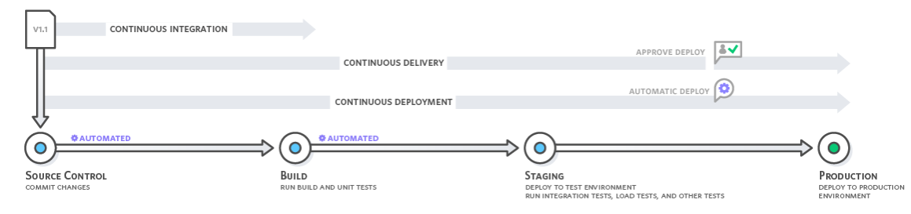
What is CD?
Continuous delivery is a DevOps software development practice where code changes are automatically built, tested, and prepared for a release to production.
In Continuous deployment production happens automatically without explicit approval.

Slide 7

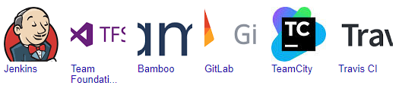
Introduction to Jenkins:
Jenkins is a self-contained, open source automation server which can be used to automate all sorts of tasks related to building, testing, and delivering or deploying software.
Integration with a wide variety of tools and technologies (Version Control Systems, Builders, Notification).

Slide 8
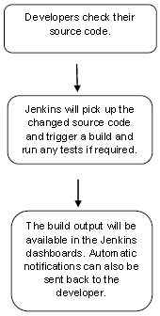
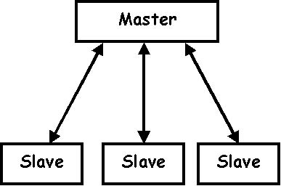
Working of Jenkins:

Slide 9
What are Environments?
The development environment normally has three server tiers, called development, staging and production.
Development Environment – provides processes and tools (IDEs) for developing
Testing Environment – setup of software and hardware
Staging Environment – looks exactly like Production Environment
Production Environment – software is deployed after the Production is done

Slide 10
Introduction to Ruby:
Ruby was introduced by Yukihiro Matsumoto (known widely as “Matz”) in Japan.
Ruby is based on Perl, Smalltalk, Eiffel, Ada and Lisp
Ruby syntax is much easier in using than other scripting languages.
Ruby can be embedded into Hypertext Markup Language (HTML)

Slide 11
Basic syntax of Ruby:
Ruby BEGIN Statement Syntax:
BEGIN {
code
}
Declares code to be called before the program is run.
Ruby END Statement Syntax:
END {
code
}
Declares code to be called at the end of the program.
Comments in Ruby:
# I am a Comment.
=begin
I am a Comment.
=end

Slide 12
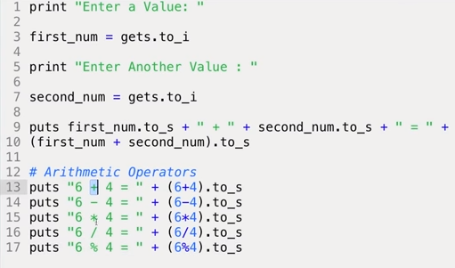
Basic Ruby Program:

Slide 13
Ruby Gems:
In Ruby, a gem is a library that contains a specific piece of functionality as well as any files or assets related to that functionality.
The gem command allows you to interact with RubyGems.
Steps to create and use your own gem:
Construct .rb and .gemspec files
Build .gemspec (It will give a .gem file)
Install Gem
Use the gem with ‘require’ keyword in any Ruby program.

Slide 14


